Slide 1
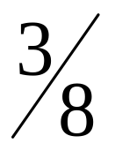
Numerical Methods
Part: Simpson Rule For Integration.

Slide 2
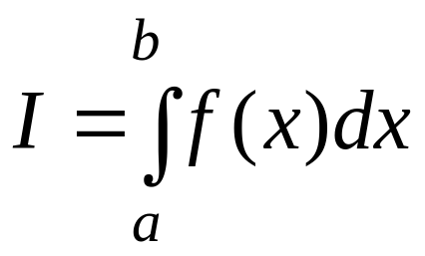
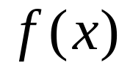


Introduction
The main objective in this chapter is to develop appropriated formulas for obtaining the integral expressed in the following form:
(1)
where is a given function.
Most (if not all) of the developed formulas for integration
is based on a simple concept of replacing a given
(oftently complicated) function by a simpler
function (usually a polynomial function) where
represents the order of the polynomial function.

Slide 3

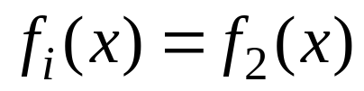
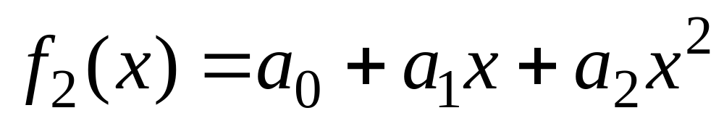
In the previous chapter, it has been explained and
illustrated that Simpsons 1/3 rule for integration can
be derived by replacing the given function
with the 2nd –order (or quadratic) polynomial function
, defined as:
(2)
http://numericalmethods.eng.usf.edu

Slide 4
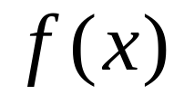

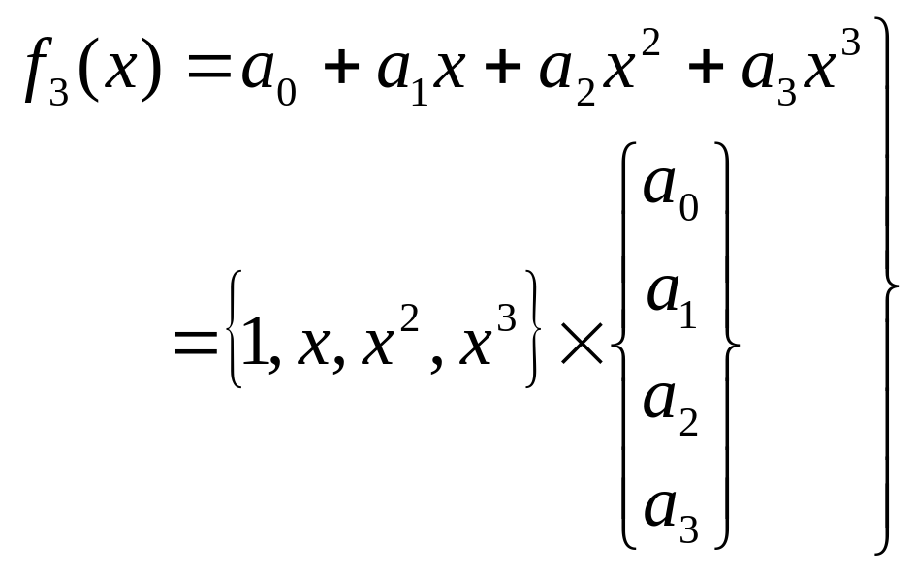
In a similar fashion, Simpson rule for integration
can be derived by replacing the given function
with the 3rd-order (or cubic) polynomial (passing
through 4 known data points) function
defined as
(3)
which can also be symbolically represented in Figure 1.

Slide 5
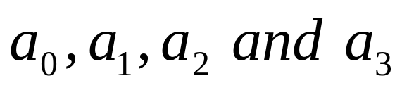
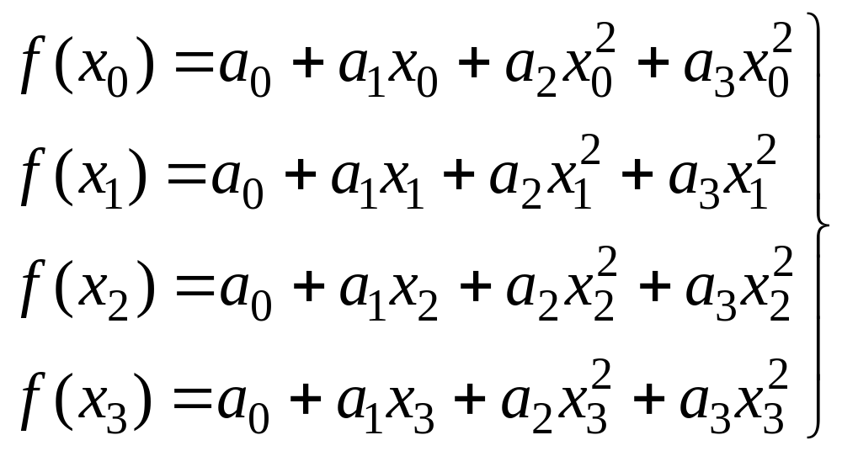
Method 1
The unknown coefficients (in Eq. (3))
can be obtained by substituting 4 known coordinate
data points
into Eq. (3), as following
(4)
http://numericalmethods.eng.usf.edu

Slide 6
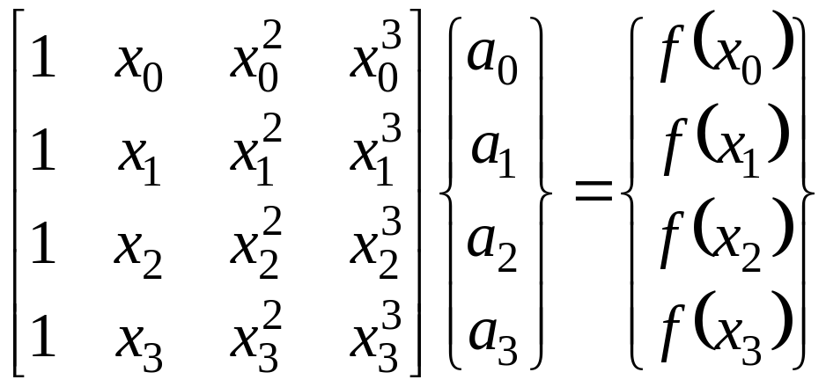
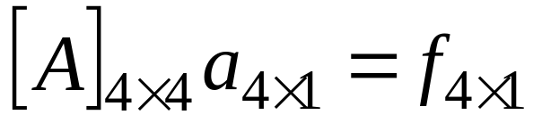
Eq. (4) can be expressed in matrix notation as
(5)
The above Eq. (5) can be symbolically represented as
(6)
http://numericalmethods.eng.usf.edu

Slide 7
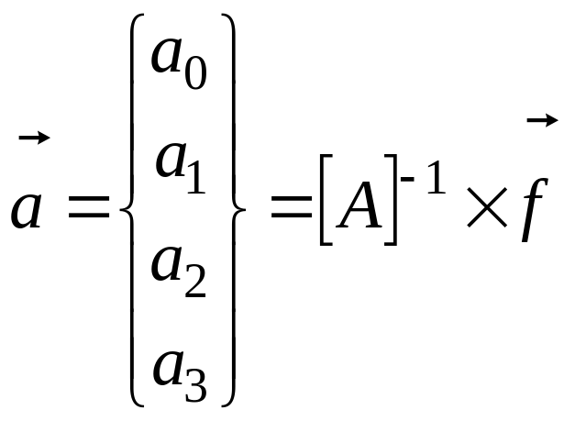
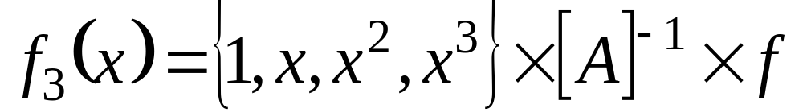
Thus,
(7)
Substituting Eq. (7) into Eq. (3), one gets
(8)
http://numericalmethods.eng.usf.edu

Slide 8
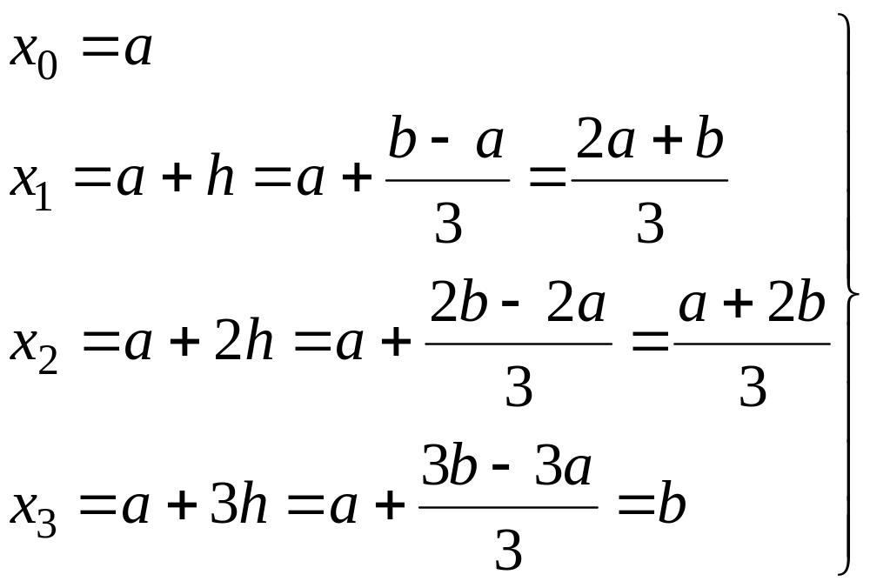

Remarks
As indicated in Figure 1, one has
(9)
With the help from MATLAB [2], the unknown vector
(shown in Eq. 7) can be solved.
http://numericalmethods.eng.usf.edu

Slide 9
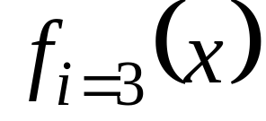
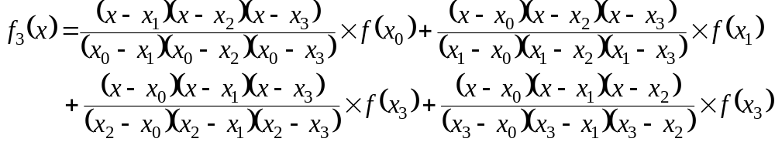
Method 2
Using Lagrange interpolation, the cubic polynomial
function
that passes through 4 data points
(see Figure 1) can be explicitly given as
(10)
http://numericalmethods.eng.usf.edu

Slide 10
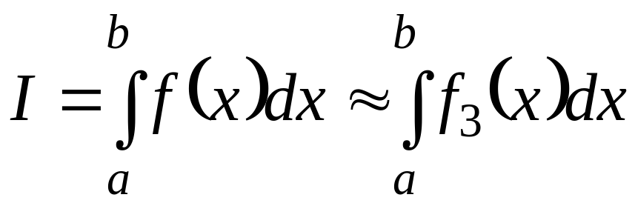
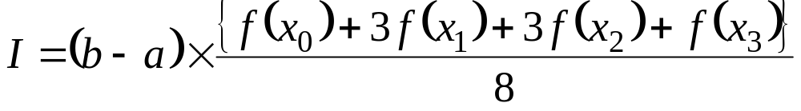
Simpsons Rule For
Integration
Thus, Eq. (1) can be calculated as (See Eqs. 8, 10 for
Method 1 and Method 2, respectively):
Integrating the right-hand-side of the above equations, one obtains
(11)
http://numericalmethods.eng.usf.edu

Slide 11
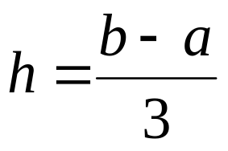

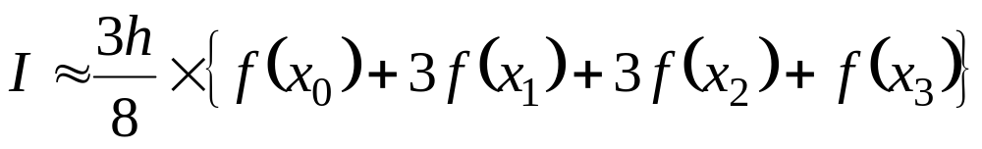
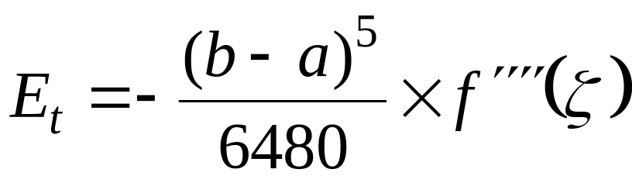
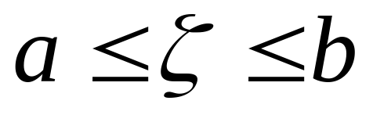
Since hence , and the above
equation becomes:
(12)
The error introduced by the Simpson 3/8 rule can be
derived as [Ref. 1]:
, where
(13)
http://numericalmethods.eng.usf.edu

Slide 12
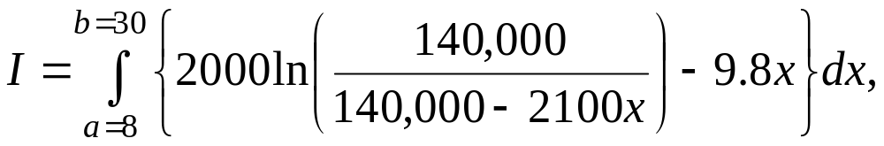
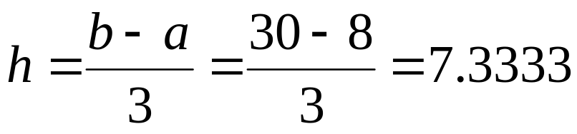
Example 1 (Single Simpson rule)
Compute
by using a single segment Simpson rule
Solution
In this example:
http://numericalmethods.eng.usf.edu

Slide 13
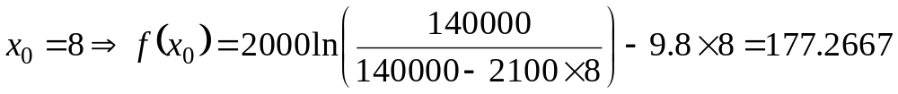
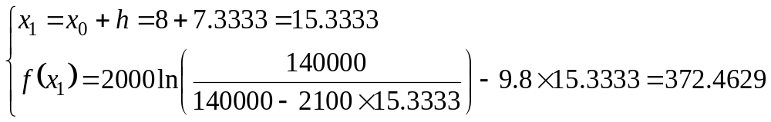
http://numericalmethods.eng.usf.edu

Slide 14
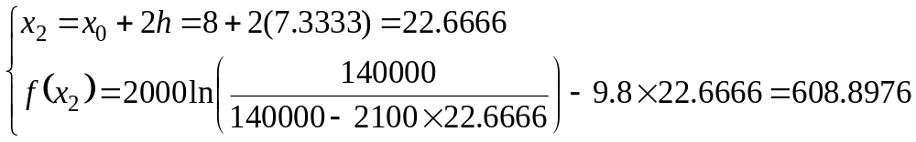
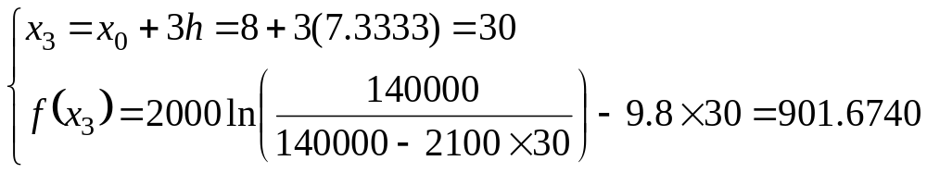
http://numericalmethods.eng.usf.edu

Slide 15
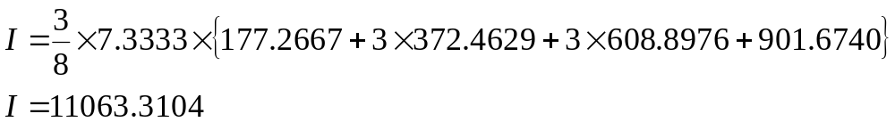
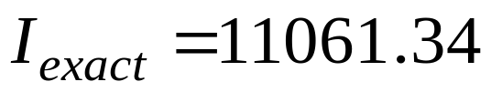
Applying Eq. (12), one has:
The “exact” answer can be computed as
http://numericalmethods.eng.usf.edu

Slide 16




3. Multiple Segments for
Simpson Rule
Using = number of equal (small) segments, the
width can be defined as
(14)
Notes:
= multiple of 3 = number of small segments
http://numericalmethods.eng.usf.edu

Slide 17

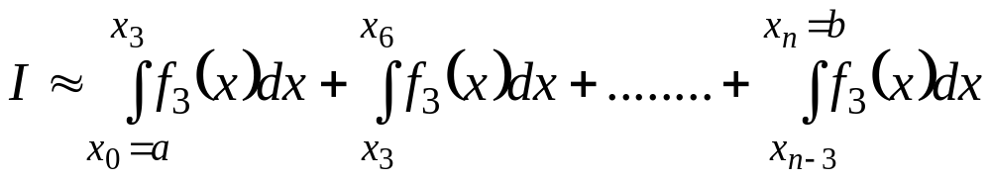
The integral, shown in Eq. (1), can be expressed as
(15)
http://numericalmethods.eng.usf.edu

Slide 18
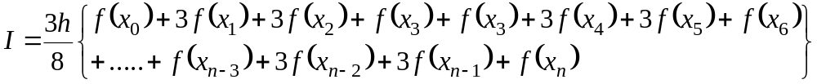
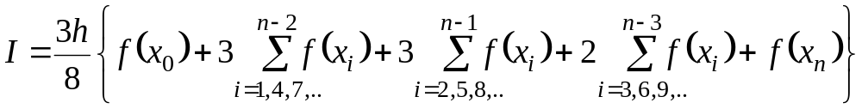
Substituting Simpson rule (See Eq. 12) into
Eq. (15), one gets
(16)
(17)
http://numericalmethods.eng.usf.edu

Slide 19
Example 2 (Multiple segments Simpson rule)
Compute
using Simple multiple segments rule, with number
(of ) segments = = 6 (which corresponds to 2
“big” segments).
http://numericalmethods.eng.usf.edu

Slide 20
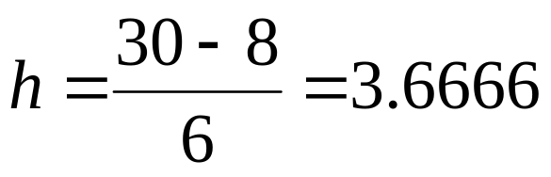

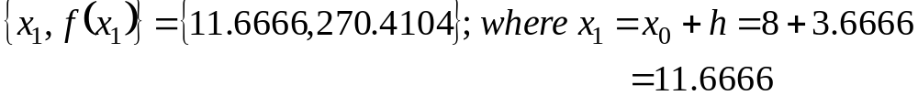
Solution
In this example, one has (see Eq. 14):
http://numericalmethods.eng.usf.edu

Slide 21
http://numericalmethods.eng.usf.edu

Slide 22
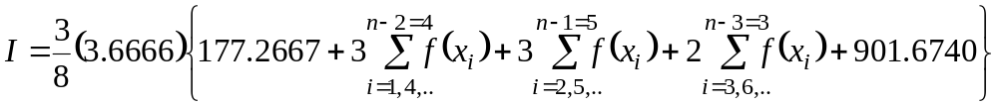

Applying Eq. (17), one obtains:
http://numericalmethods.eng.usf.edu

Slide 23
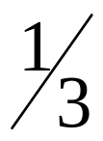
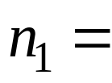
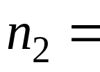
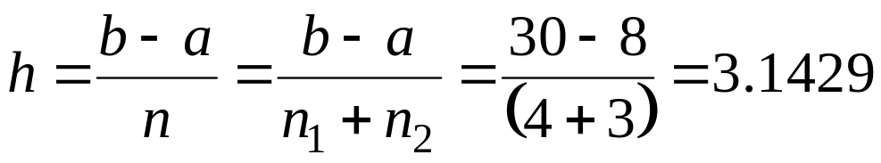
Example 3 (Mixed, multiple segments Simpson and
rules)
Compute
using Simpson 1/3 rule (with 4 small segments), and
Simpson 3/8 rule (with 3 small segments).
Solution:
In this example, one has:
http://numericalmethods.eng.usf.edu

Slide 24
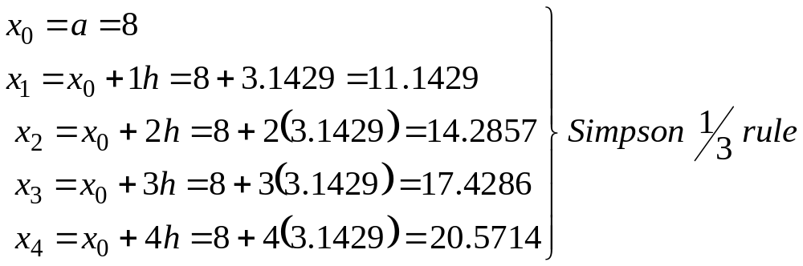
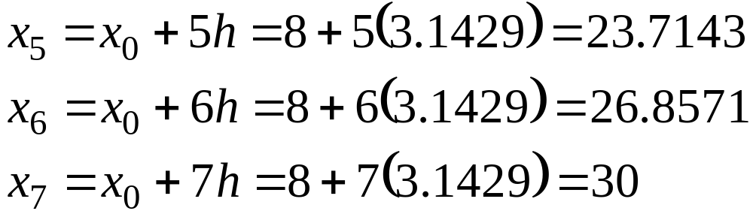
http://numericalmethods.eng.usf.edu

Slide 25
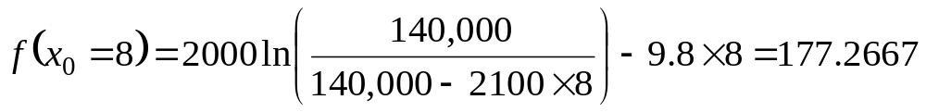
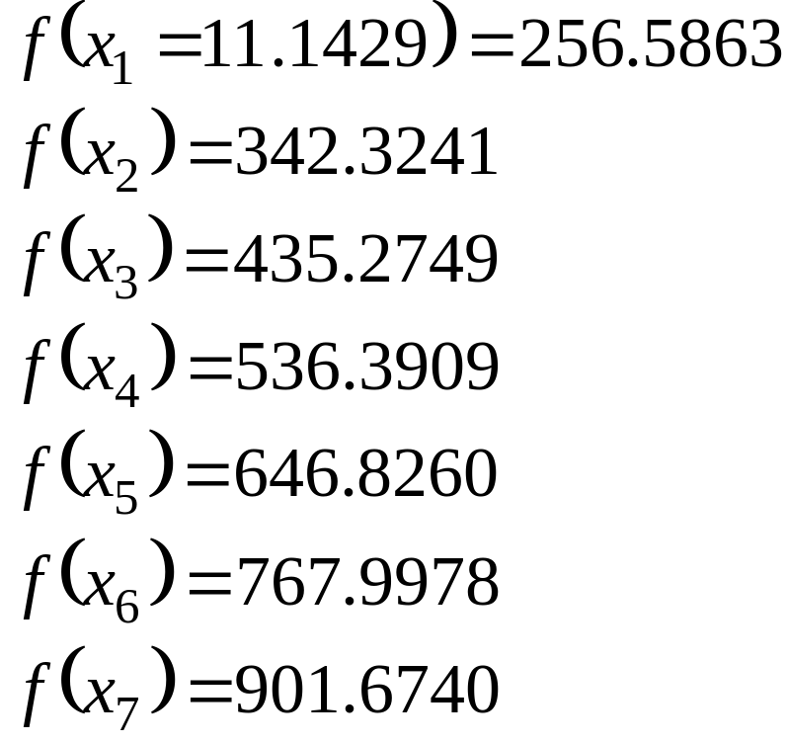
Similarly:
http://numericalmethods.eng.usf.edu

Slide 26
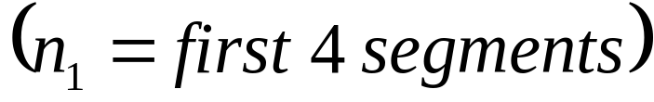

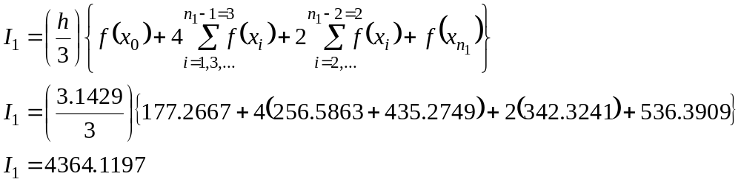
For multiple segments
using Simpson rule, one obtains (See Eq. 19):
http://numericalmethods.eng.usf.edu

Slide 27
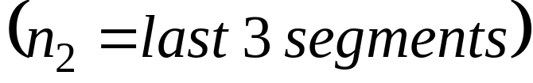
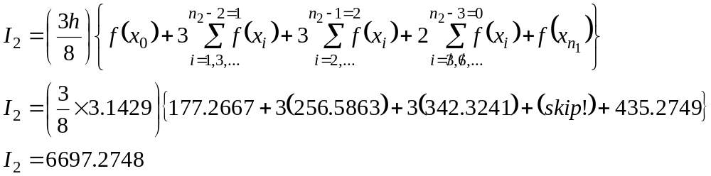
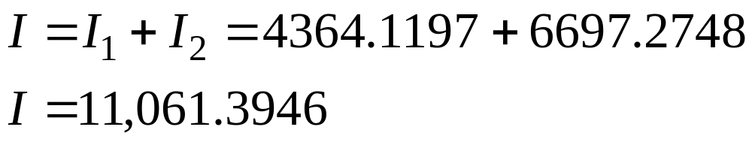
For multiple segments
using Simpson 3/8 rule, one obtains (See Eq. 17):
The mixed (combined) Simpson 1/3 and 3/8 rules give:
http://numericalmethods.eng.usf.edu

Slide 28
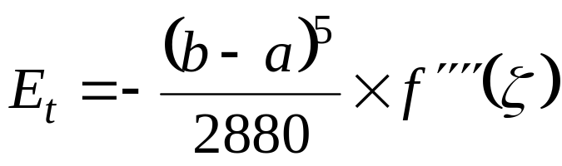
Remarks:
(a) Comparing the truncated error of Simpson 1/3 rule
(18)
With Simple 3/8 rule (See Eq. 13), the latter seems to
offer slightly more accurate answer than the former.
However, the cost associated with Simpson 3/8 rule
(using 3rd order polynomial function) is significant
higher than the one associated with Simpson 1/3 rule
(using 2nd order polynomial function).
http://numericalmethods.eng.usf.edu

Slide 29

(b) The number of multiple segments that can be used
in the conjunction with Simpson 1/3 rule is 2,4,6,8,..
(any even numbers).
(19)
http://numericalmethods.eng.usf.edu

Slide 30
However, Simpson 3/8 rule can be used with the
number of segments equal to 3,6,9,12,.. (can be
either certain odd or even numbers).
(c) If the user wishes to use, say 7 segments, then the
mixed Simpson 1/3 rule (for the first 4 segments),
and Simpson 3/8 rule (for the last 3 segments).
http://numericalmethods.eng.usf.edu

Slide 31



4. Computer Algorithm For Mixed Simpson
1/3 and 3/8
rule For Integration
Based on the earlier discussions on (Single and Multiple
segments) Simpson 1/3 and 3/8 rules, the following
“pseudo” step-by-step mixed Simpson rules can be given
as
Step 1 User’s input information, such as
Given function integral limits
= number of small, “h” segments, in conjunction with
Simpson 1/3 rule.
http://numericalmethods.eng.usf.edu

Slide 32



= number of small, “h” segments, in conjunction with
Simpson 3/8 rule.
Notes:
= a multiple of 2 (any even numbers)
= a multiple of 3 (can be certain odd, or even
numbers)
http://numericalmethods.eng.usf.edu

Slide 33



Step 2
Compute
http://numericalmethods.eng.usf.edu

Slide 34

Step 3
Compute “multiple segments” Simpson 1/3 rule (See
Eq. 19)
(19, repeated)
http://numericalmethods.eng.usf.edu

Slide 35


Step 4
Compute “multiple segments” Simpson 3/8 rule (See
Eq. 17)
(17, repeated)
Step 5
(20)
and print out the final approximated answer for I.
http://numericalmethods.eng.usf.edu

